Slide 1

The Importance of Crushing Dreams
Notes:
You should not want to crush all of your students’ dreams.
However, I believe we should disabuse our students’ belief that mathematics is a magic wand applicable to all problems. We do not want them to believe math, applied to physical, social and political problems is an unerring and unarguable source of objective truth.

Slide 2

Math is not magic
Notes:
Vaccine ~$200 for a child, $54,000 for Sutent for 6 months
Bruce Hardy
http://www.nytimes.com/2008/12/03/health/03nice.html?pagewanted=all
Bruce Hardy was a 54 year old man whose kidney cancer had metastasized to his lungs. His doctors recommended that he use a drug Sutent for $54,000. The British national health care service determined this drug would only be expected to extend Mr. Hardy’s life 6 months, and the service was only willing to spend $22,750 for that amount of life extension.
It is not clear which side is correct, but there is a temptation to establish sharp, quantitative lines and absolve yourself of the responsibility for the resulting moral choice.
If math cannot be a magical solution to our dilemmas, what can we expect from math?

Slide 3


Things exist which Math can prove to be true:
Given the standard axioms of arithmetic, there are no integer solutions to the equation:
$$x^{2}−2y^{2}=0$$
Notes:
Math is absolutely precise, for a limited set of problems.

Slide 4

Things exist which Math and Science believe to be true, given our current understanding:
Populations vary. Some of this variation is heritable, and some of this variation confers a benefit in a given environment. Individuals with beneficial variation will survive and reproduce more successfully than individuals without that variation, and they will pass that variation on to their offspring.

Slide 5

Things exist which Math and Science can evaluate the likelihood of being true:
It is now more certain than ever, based on many lines of evidence, that humans are changing Earth’s climate. The atmosphere and oceans have warmed, accompanied by sea-level rise, a strong decline in Arctic sea ice, and other climate-related changes.

Slide 6

Things exist which Math and Science will almost certainly never have understanding to judge:
We hold these truths to be self evident: that all men and women are equal.

Slide 7
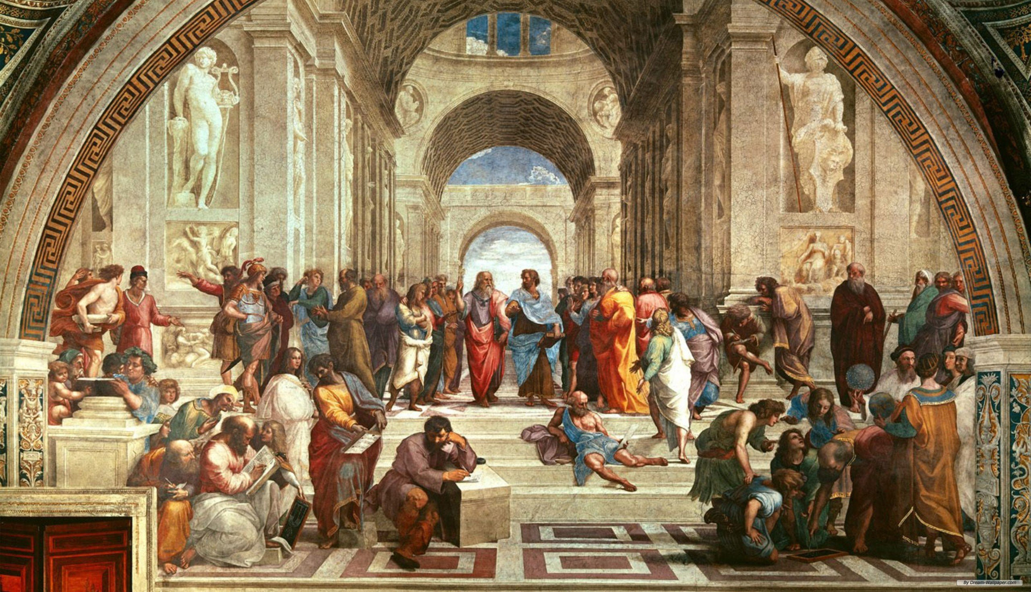
Notes:
Everything you teach your students is important:
Most fundamentally, you are teaching competence in manipulating the ideas and forms of mathematics.
Equally important, your students need to understand the differences between the levels of knowledge and certainty provided by math and science discussed above.
Finally, your personal example, as well as the example and knowledge provided by all of your colleagues in your schools, show students what it means to be a decent person, and provide context as they seek to apply the skills you teach them to improve the world.

Slide 8
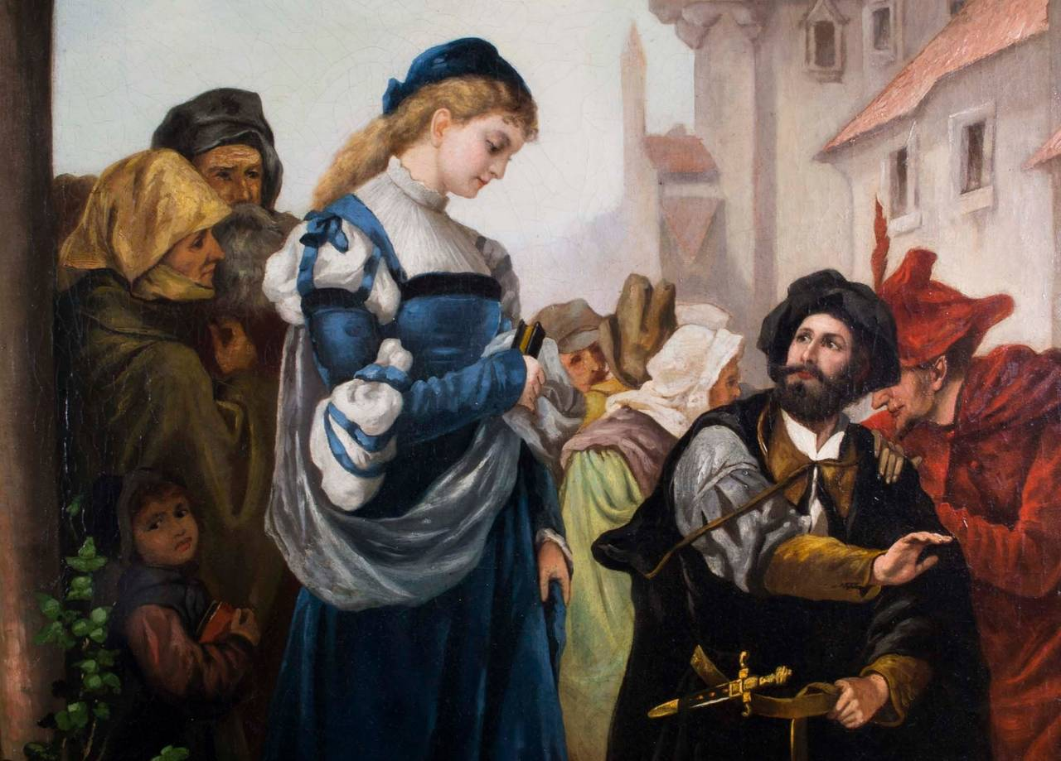
Notes:
Your students will have opportunities to change the world. Math is a powerful tool to inform their decisions and actions. Examples abound of people using mathematics for good and for ill. I will use these examples to show how powerful mathematics can be, as well as how your students’ appreciation of the limitations of mathematics and their knowledge outside of mathematics determines the outcome of its use.
Like much human endeavor, application of mathematics can go spectacularly wrong. To keep our spirits up, we will start with an example of superlative good.

Slide 9
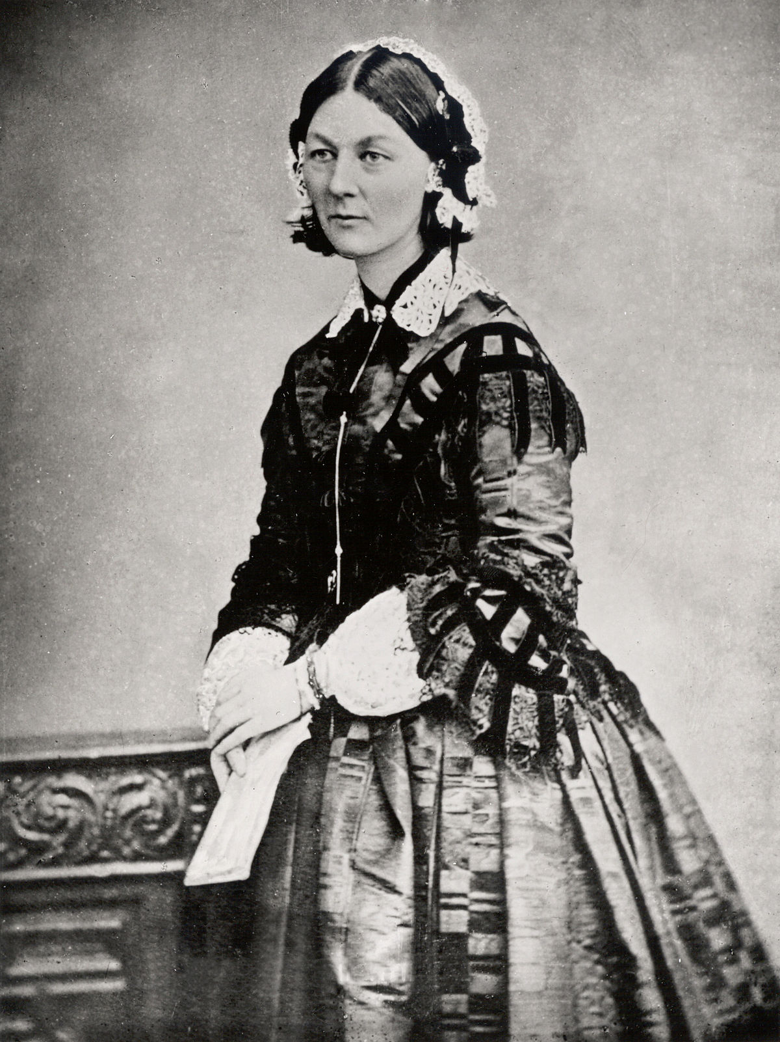
Notes:
Florence Nightingale was born in 1820 to a wealthy, well-connected family. Her father provided tutors for her, including in mathematics. The reasons for this are unclear, since a woman of her status and at that time could only aspire to raising a family. Since the study of mathematics was clearly denied to her, Florence Nightingale chose to pursue nursing. This was a shocking development, since only prostitutes and Catholics acted as nurses. In fact, Florence Nightingale had to travel to Germany to study with an order of nursing sisters to receive the training she required.

Slide 10
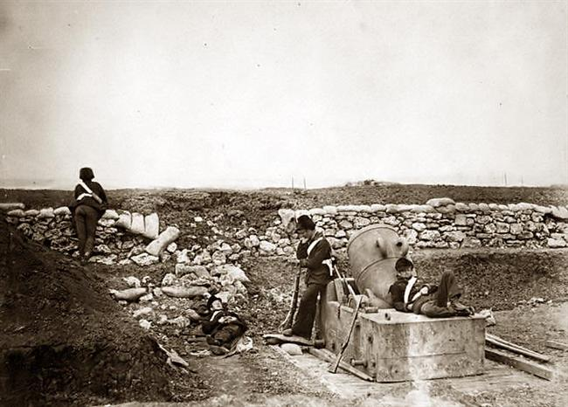
Notes:
In 1853 England joined France in a war against the Russian Empire in support of the Ottoman Empire. England hadn’t fought against a European power since defeating Napoleon in 1815, and they were woefully unprepared. The casualties, primarily from disease and infection appalled the nation and threatened the government. Florence Nightingale lead 38 volunteers to the Black Sea where she began providing what aid she could to the ill and injured. She also wrote to friends in England requesting a sanitary commission evaluate conditions. The sanitary commission was able to enact several reforms, draining cesspools around the hospitals, providing clean water and adequate nutrition. The result was that the casualties became almost entirely due to wounds. Eventually the war ended, and everyone returned home.

Slide 11
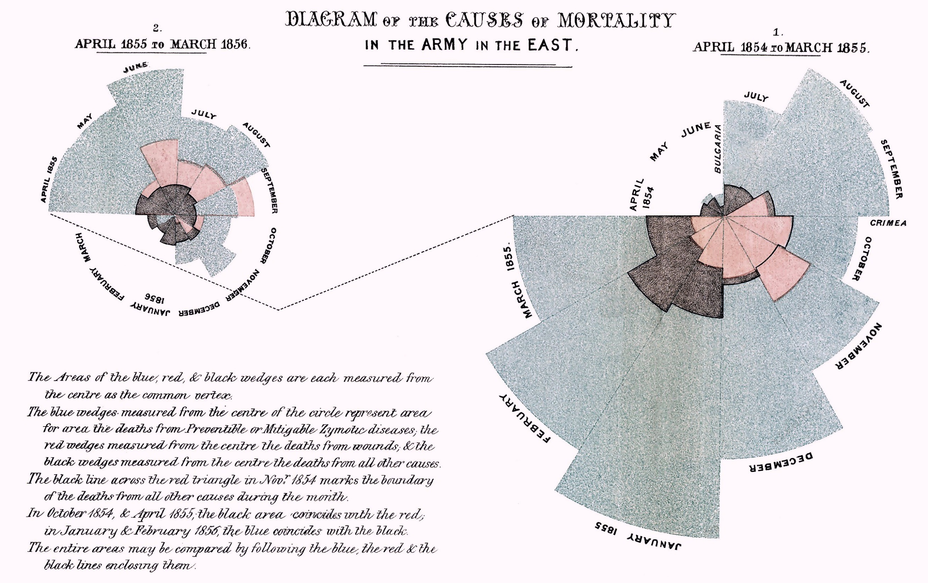
This type of chart “affect(s) thro’ the eyes what we fail to convey to the public through their word-proof ears.”
Notes:
While in the Crimea, Florence Nightingale kept meticulous records. She prepared a report on the conditions she found and essentially invented the pie chart to show how mortality had dropped once proper public health was put in place. The response of the army was to pat her on the head, note these were exceptional conditions and she should just run along.
So she did, starting a tour of England and stopping at every city where the army had a major barracks located. She again kept meticulous records, and this time using bar charts, she showed that soldiers in the army were dying at as much as twice the rate of the civilians in the exact same location. Finally, her data was so compelling that the army was forced to reform and embrace public health and sanitation as part of its mission.
This is a remarkable story of a woman, with no official status in her society, who used high quality data, analysis and clear presentation of results to force the most hide-bound of male-dominated institutions to change its behavior. Despite the checkered history of the British Empire, its embrace of and promotion of sanitation and public health has been an unalloyed good.

Slide 12
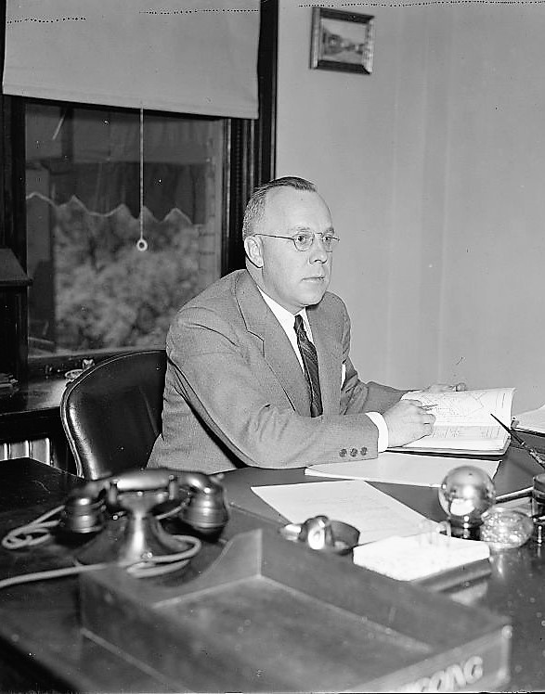
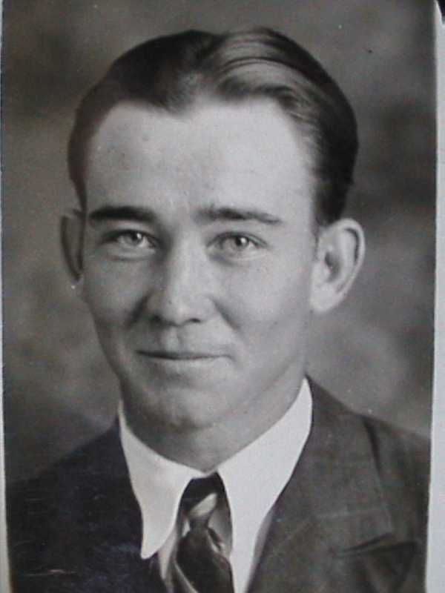
Notes:
We now consider the work of two men, favored by education and class. These two men have had an outsized, if largely unacknowledged role, in shaping the country we live in. You could argue that these men, in combination with some of their even lesser known colleagues, are most responsible for modern America.
Before we look at their story, it is absolutely vital that you take to heart the following information:

Slide 13
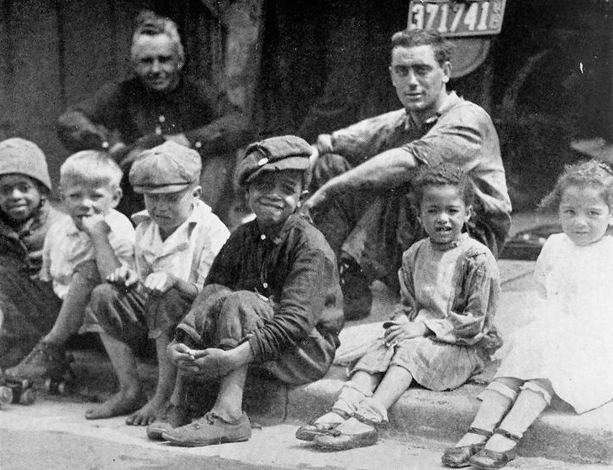
Biologically, race does not exist

Slide 14
“Humans are an amazingly diverse species, but this diversity is not due to a finite number of subtypes or races”
“adaptive traits do not define races in humans”
  “adaptive traits reflect the underlying environmental factor to which they are adaptive and not overall genetic differentiation”
  “different adaptive traits define discordant groups”
  “There are no objective criteria for choosing one adaptive trait over another to define race”
“A tree-like structure among humans has been falsified whenever tested, so this practice is scientifically indefensible”
“the vast majority of human genetic diversity reflects local adaptations and, most of all, our individual uniqueness”
Templeton, Alan R., “Biological Races In Humans,” Stud Hist Philos Biol Biomed Sci. 2013 September ; 44(3): 262–271
Notes:
Templeton, Alan R., “Biological Races In Humans,” Stud Hist Philos Biol Biomed Sci. 2013 September ; 44(3): 262–271

Slide 15
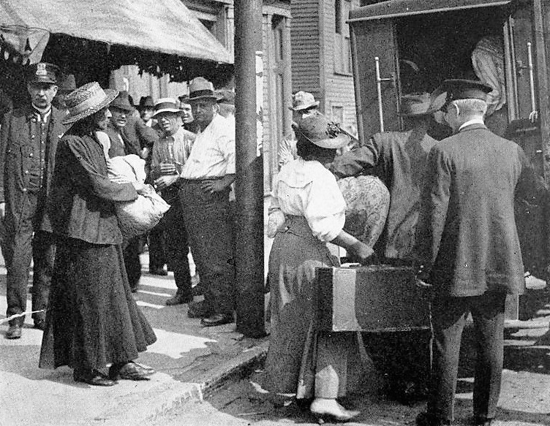
Socially, culturally, politically, Racism exists
Notes:
As important as it is to realize that there is no scientific rationale for racism, it is equally important to realize that racism certainly exists, and it creates measurable harm to people suffering from society’s continued embrace of it.

Slide 16

Real Estate Prior to the
Federal Housing Authority (FHA)

Slide 17
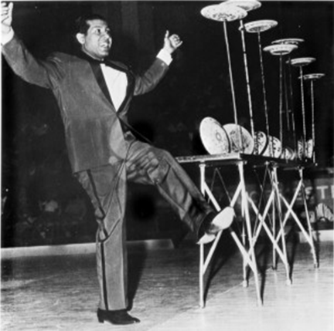
Short Term Balloon Loans
These loans typically lasted 3-5 years.
They would be issued for no more than 60% of the property’s value.
The borrower paid interest during the life of the contract.
At the end of the contract the borrower repaid the principal.

Slide 18
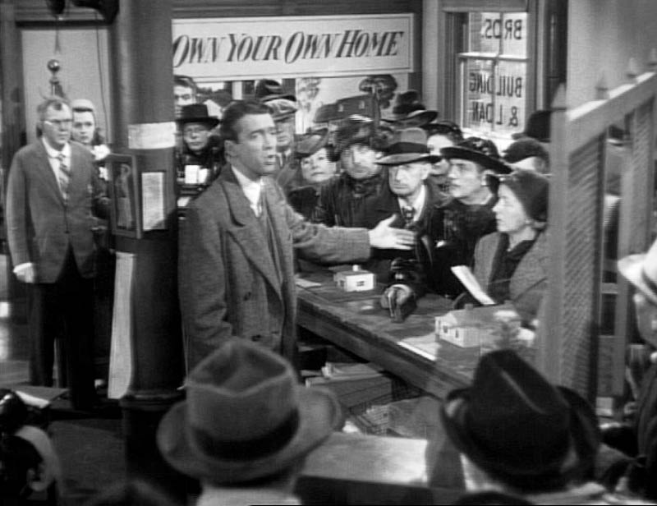
Building and Loan Share Accumulation Contracts
The borrower paid more than the interest on their loan monthly.
The non-interest portion was invested in Building and Loan shares.
Over time the shares earned dividends and accumulated to the point at which the funds equaled the principal and the borrower received title to their home.

Slide 19

Second Mortgage Loans
To lower the down payment required for a home, many people had to secure a second mortgage.
Typical terms included an effective interest rate of 11.6% (compared with 7.2% for first mortgages) and a 2% of principal payment each month (so the principal was fully paid at the end of five years.)
The lenders were less mature: e.g., previous home-owners, building construction companies.

Slide 20
Real Estate Prior to the FHA
Notes:
Home Owners Loan Corporation (HOLC)
This was a short term program which issued bonds, and then used the bonds from 1933 to 1935 to purchase troubled loans.
Federal Housing Authority (FHA) Mortgage Underwriting
This was a long term program which provided insurance on new mortgages.
Mortgage holders could give a defaulting loan to the FHA and receive compensation.
HOLC was intended to stabilize the home financing industry, to relieve people in danger of losing their homes and to promote amortized, long-term mortgages.
The FHA Mortgage guarantee was intended to increase the availability of credit, create a market for mortgages, improve standards in housing, and promote new construction.

Slide 21
Implementation

Slide 22
Rating of Property

Slide 23
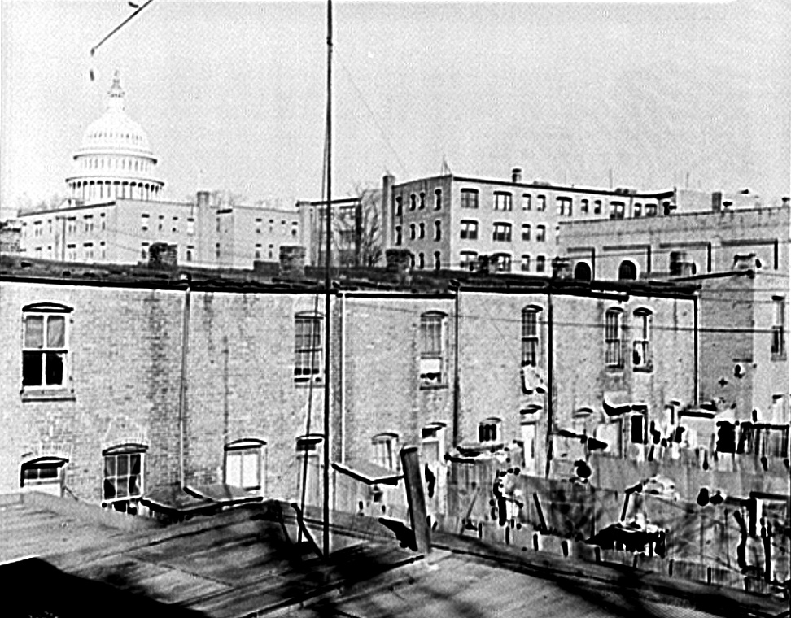
156(2)
It is a demonstrated axiomatic principle of mortgage lending that a harmonious relationship between properties within an immediate neighborhood area tends to lessen the risk involved in mortgage investments. Many forms of nonconformity adversely affect the marketability of properties. One of the most pronounced is that of over-improvement or under-improvement. …

Slide 24
Rating of Borrower

Slide 25
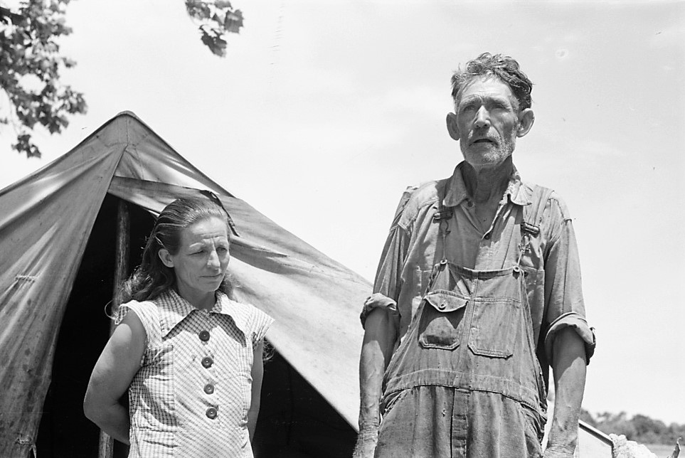
317 – Attitude toward obligations
…The meeting of his obligations will be a serious matter with him, and he will save, plan and budget his income in order to meet his mortgage payments fully and promptly. He will be found to regard his home ties and relationships as imposing upon him responsibilities in the prompt discharge of which he must be scrupulously faithful. With regard to mortgage loans, it is usually found that borrowers with domestic responsibilities are more dependable than those without such responsibilities. This is especially true in cases where the wife is efficient in household economy and motivates and inspires the husband to apply himself closely to his work and urges him to regard the payment of his just debts as a requirement somewhat of the nature of a sacred obligation

Slide 26
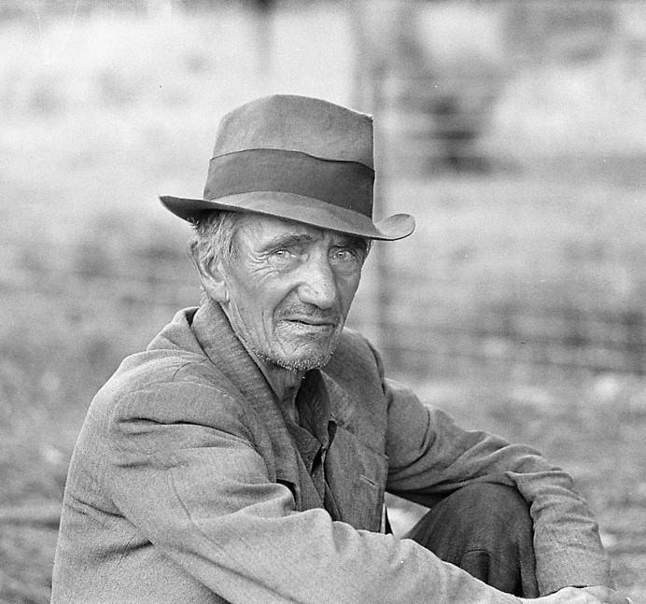
327 – Future Prospects
... Effort should be made to ascertain the extent of his natural ability. Inquiry should also be made to determine the extent and nature of his ambitions; whether or not he is interested in educating himself more thoroughly in his business or field of commercial endeavor; whether or not he is resourceful, mentally alert, or lazy and apathetic. Many other lines of inquiry will commend themselves to the Mortgage Risk Examiner in rating the borrower's future prospects. The conclusion which is sought and which sums up the whole matter may be found in the answer to the questions: "Is the borrower self-satisfied or ambitious? Is his mental capacity such as to permit or assure business and other progress?"

Slide 27
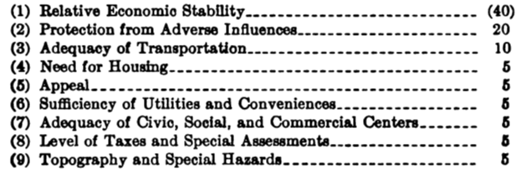
Rating of Location

Slide 28
201
The following definitions are used:
(1) Location is defined as the actual site of a property viewed in terms of its relationship with its immediate surroundings and general economic background.
(2) Rating of Location is defined as the process of determining the degree of mortgage risk attributable to location. "Rating of Location" also refers to the percentage expression which results from the process.
(3) Established Rating of Location is defined as rating of a selected location which is used as a basis of comparison in connection with the rating of other locations in the same neighborhood.
(4) Neighborhood is defined as a single area composed of locations separated only by publicly-used land, the residential portions of which exhibit a degree of homogeneity. In general, a neighborhood is available for or improved with dwellings of more or less similar character, age, and quality.
(5) Outlined Neighborhood is defined as a neighborhood in which the approximate borders have been established and in which Established Ratings of Location have been completed and made available to Valuators.

Slide 29
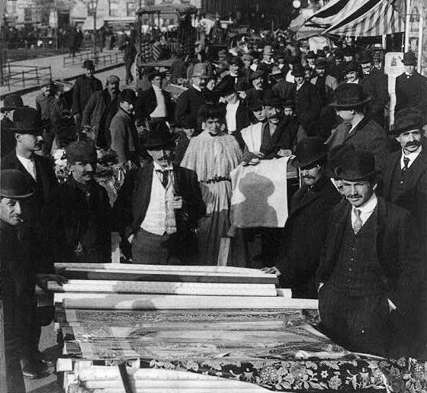
210 (d)
… The mixed neighborhood in competition with a modern, homogeneous area will invariably suffer, since the chances are that within a comparatively short period of time a lower grade of social occupancy will exist. The past has demonstrated that where entire neighborhoods or subdivisions were laid out forty years ago with a well-executed, conscious effort to develop beauty and charm in an economical manner, the areas have tended to continue in high favor, although other neighborhoods just as favorably situated, but where no effort was made for planning or homogeneous development, have suffered and are now occupied by owners or tenants of a markedly lower social and financial class. … The mixed neighborhoods with heterogeneous types of properties and methods of construction with varying sizes of homes and age groups of structures, when placed in competition with the better areas, will retrograde at a much faster rate in the future than they have in the past, regardless of the probability that population increase may be at a much slower rate in future years.

Slide 30
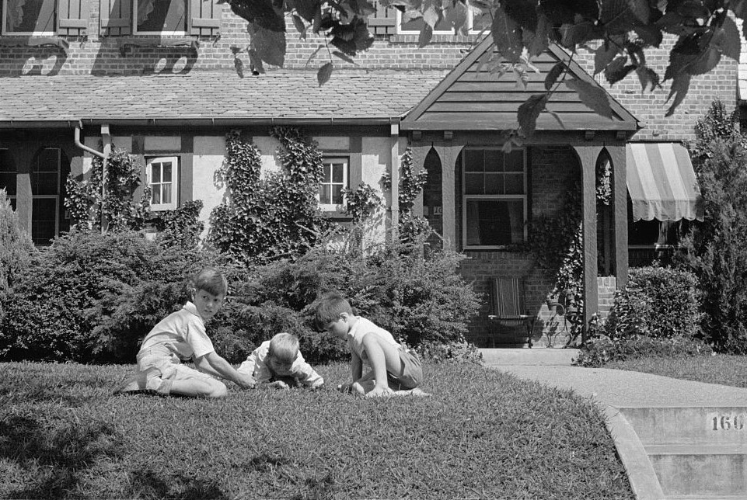
216
The effect of the economic background upon the risk involved in mortgages has been recognized by mortgage lenders. Some companies have excluded entire cities from their lists of acceptable areas. Others have limited their activities to cities beyond definite population sizes and have favored selected locations within the accepted larger metropolitan areas. It is not the policy of the Federal Housing Administration to exclude entire cities and towns from the benefits of mutual mortgage insurance. It may well be, however, that within certain communities whose present-day and expected future stability is exceedingly low, only certain favored locations which surpass the general average of the town or community may prove acceptable for insurance. The rating ascribed shall apply to all locations situated in the area rated. …

Slide 31
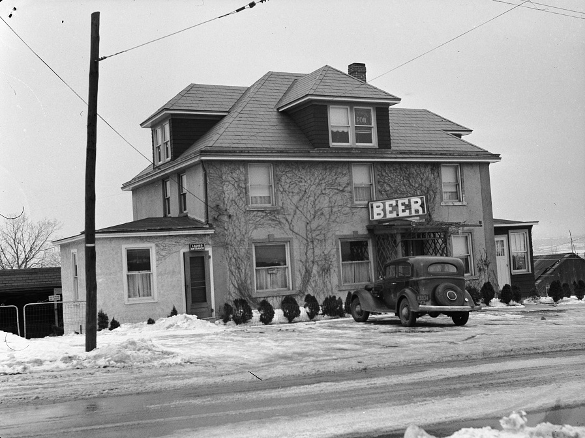
222
… If a few rental properties are occupied by tenants of radically lower income-level than that of the typical property owners, and if it is determined that the presence of the lower income-level occupants is indicative of the characteristics of future typical occupants in the area, the income characteristics of the tenants should control judgment. This applies to neighborhoods in transition where the first indication of blight is usually the introduction of lower income-level tenants.

Slide 32
226 – Protection from Adverse Influences
This feature has a total weight of 20, making it one of the most important features in the Rating of Location. Protection from adverse influences is not concerned merely with zoning and deed restrictions. These are of great importance, but they do not represent all of the protection which is or may be afforded a location. Where little or no protection is provided against adverse influences the Valuator must not hesitate to make a reject rating of this feature

Slide 33
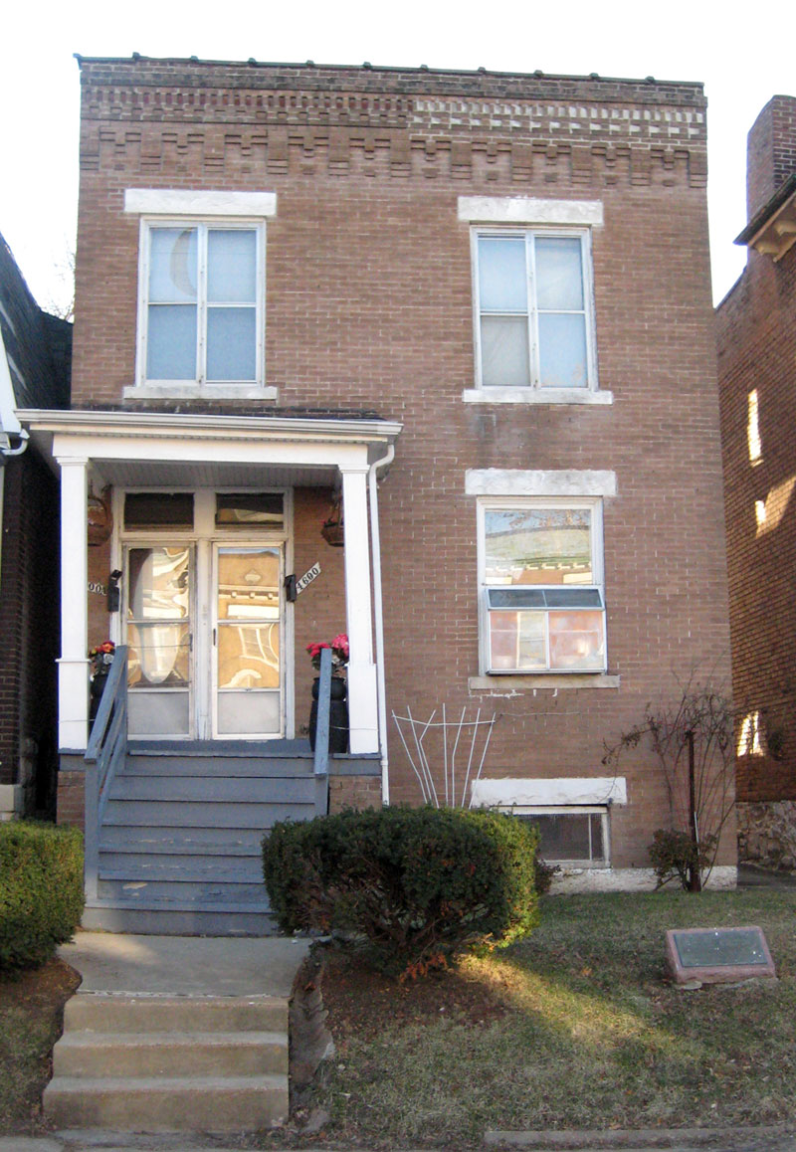
228 – Protection from Adverse Influences
Deed restrictions are apt to prove more effective than a zoning ordinance in providing protection from adverse influences. Where the same deed restrictions apply over a broad area and where these restrictions relate to types of structures, use to which improvements may be put, and racial occupancy, a favorable condition is apt to exist. Where adjacent lots or blocks possess altogether different restrictions, especially for type and use of structures and racial occupancy, the effect of such restrictions is minimized and adequate protection cannot be considered to be present. … It must be realized that deed restrictions, to be effective, must be enforced. …
Street level view of the Shelley House in St. Louis, Missouri, USA, FrancisNancy, https://commons.wikimedia.org/wiki/File:Shelley_house_lg.jpg

Slide 34
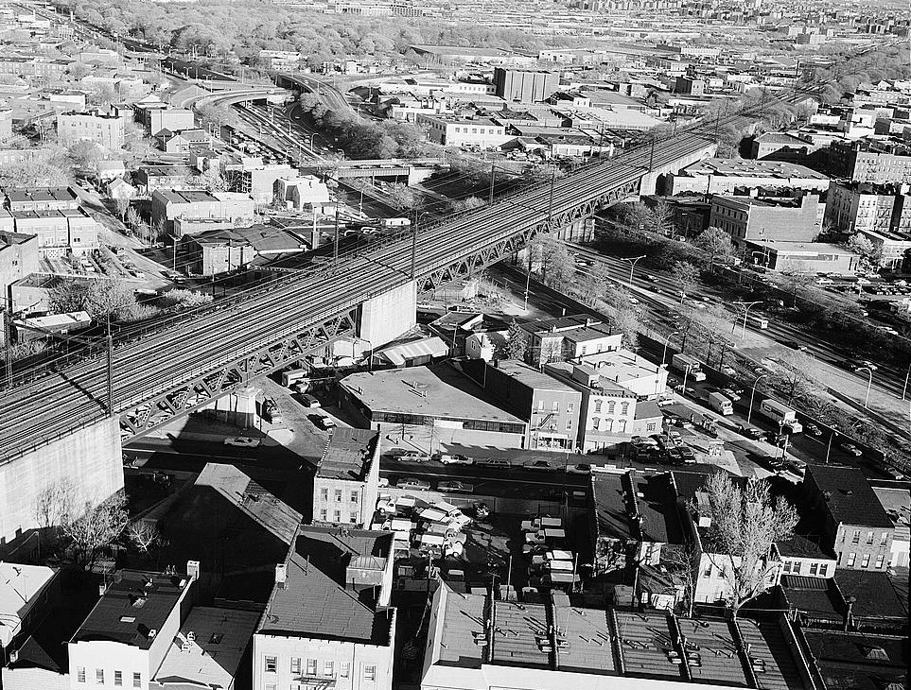
229 – Protection from Adverse Influences
… Natural or artificially established barriers will prove effective in protecting a neighborhood and the locations within it from adverse influences. Usually the protection against adverse influences afforded by these means include prevention of the infiltration of business and industrial uses, lower-class occupancy, and inharmonious racial groups. A location close to a public park or area of similar nature is usually well protected from infiltration of business and lower social occupancy coming from that direction. …

Slide 35
233
The Valuator should investigate areas surrounding the location to determine whether or not incompatible racial and social groups are present, to the end that an intelligent prediction may be made regarding the possibility or probability of the location being invaded by such groups. If a neighborhood is to retain stability it is necessary that properties shall continue to be occupied by the same social and racial classes. A change in social or racial occupancy generally leads to instability and a reduction in values. The protection offered against adverse changes should be found adequate before a high rating is given to this feature. Once the character of a neighborhood has been established it is usually impossible to induce a higher social class than those already in the neighborhood to purchase and occupy properties in its various locations.

Slide 36
266 - Adequacy of Civic, Social, and Commercial Centers
The social class of the parents of children at the school will in many instances have a vital bearing. Thus, although physical surroundings of a neighborhood area may be favorable and conducive to enjoyable, pleasant living in its locations, if the children of people living in such an area are compelled to attend school where the majority or a goodly number of the pupils represent a far lower level of society or an incompatible racial element, the neighborhood under consideration will prove far less stable and desirable than if this condition did not exist. In such an instance it might well be that for the payment of a fee children of this area could attend another school with pupils of their same social class. The question for the Valuator to determine is the effect created by the necessity for making this payment upon the occupants of the location. Under any conditions the rating could not be as favorable as if the desirable school were available without additional cost. In many instances where a school has earned a prestige through the class of pupils attending, it will be found that such prestige will be a vital element in maintaining the desirability of the entire area comprising the school district.

Slide 37
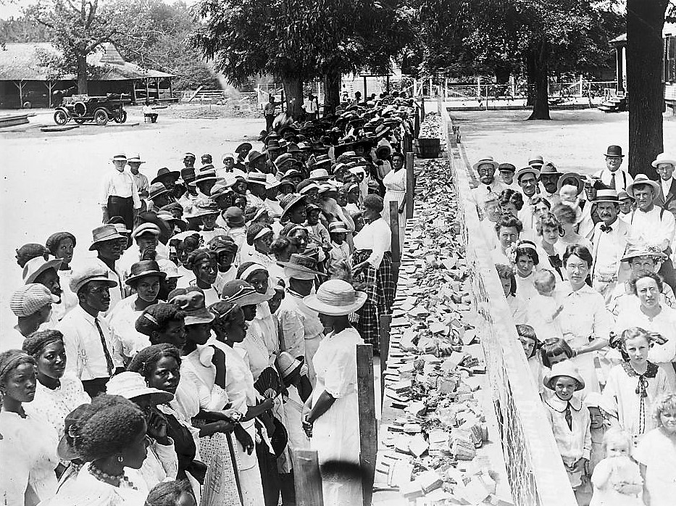
284(3)
Recorded deed restrictions should strengthen and supplement zoning ordinances and to be really effective should include the provisions listed below. The restrictions should be recorded with the deed and should run for a period of at least twenty years. Recommended restrictions include the following:
…
(g) Prohibition of the occupancy of properties except by the race for which they are intended.
(h) Appropriate provisions for enforcement

Slide 38
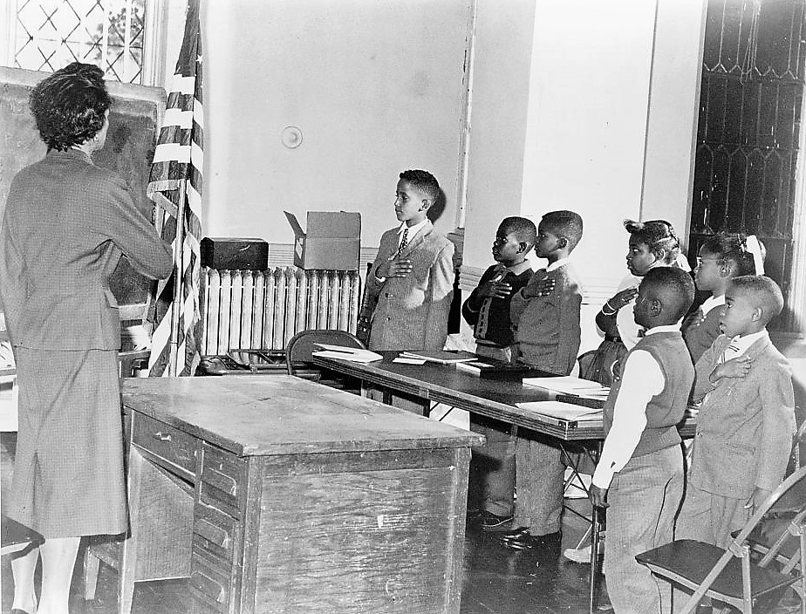
289(1)
Adequacy of Civic, Social, and Commercial Centers. —… Schools should be appropriate to the needs of the new community and they should not be attended in large numbers by inharmonious racial groups. …

Slide 39

History judges us harshly
Notes:
Even though I think it is important that we realize that the future will judge us harshly, the essential lesson is to be aware of how our own biases can affect what we present as objective analyses of fact. We should always be suspicious of analyses which encourage cruelty or unfair allocation of costs.

Slide 40
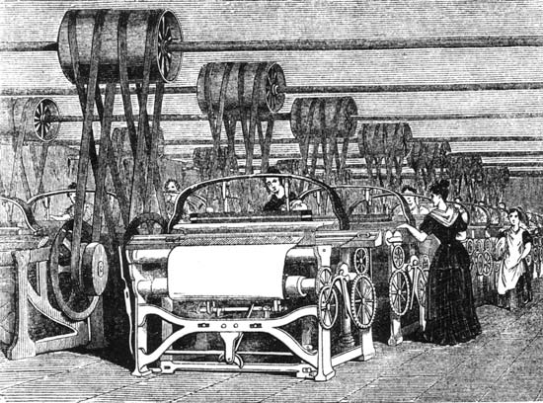
Resources exist to expose students to the dilemmas of applied math and science.

Slide 41



The PIC Math Program
Preparation for Industrial Careers in Mathematical Sciences prepares mathematical sciences students for industrial careers by engaging them in research problems that come directly from industry.
Increase awareness among math and statistics faculty and undergraduates about non-academic career options.
Provide research experience working on real-world problems from business, industry and government.
Prepare students for industrial careers.
Michael Dorff, BYU
S. L. Weekes, WPI
DMS 1345499

Slide 42

The PIC Math Program
Preparation for Industrial Careers in Mathematical Sciences prepares mathematical sciences students for industrial careers by engaging them in research problems that come directly from industry.
http://www.maa.org/pic-math
Michael Dorff, Brigham Young University & SLWeekes
DMS 1345499

Slide 43
Spring Semester Research Course
PIC Math faculty run a spring semester, credit-bearing course on solving industrial problems
Information about industrial careers
Training for industrial careers
PIC Math provides material, financial, and emotional support material for the course

Slide 44

We should teach students to question us.
Notes:
Why are we doing this? Is it right to do this as we are planning? Should we be doing this?

Slide 45
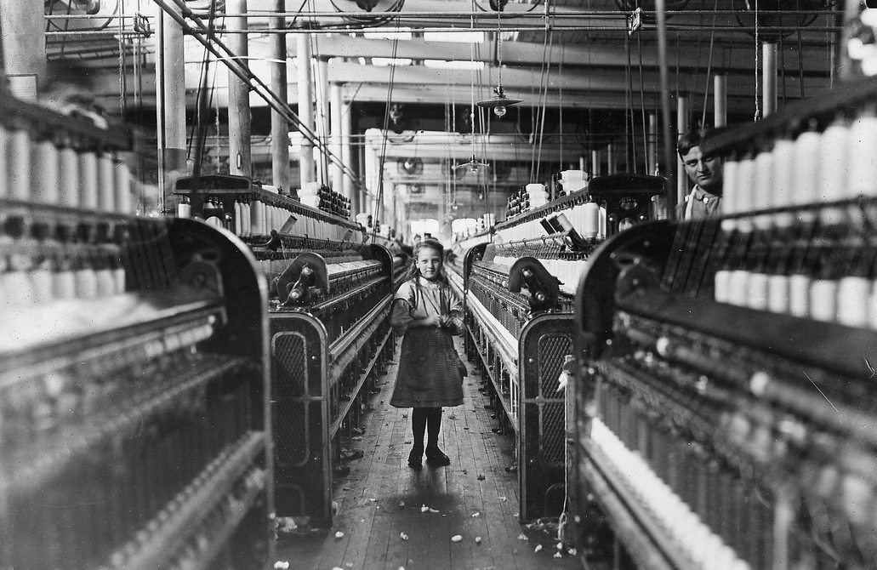
The preloading process at the facility needs to be maximized so that they have the least amount of workers doing the most amount of work in the least amount of time.
Notes:
The preloading process at the facility needs to be maximized so that they have the least amount of workers doing the most amount of work in the least amount of time.

Slide 46
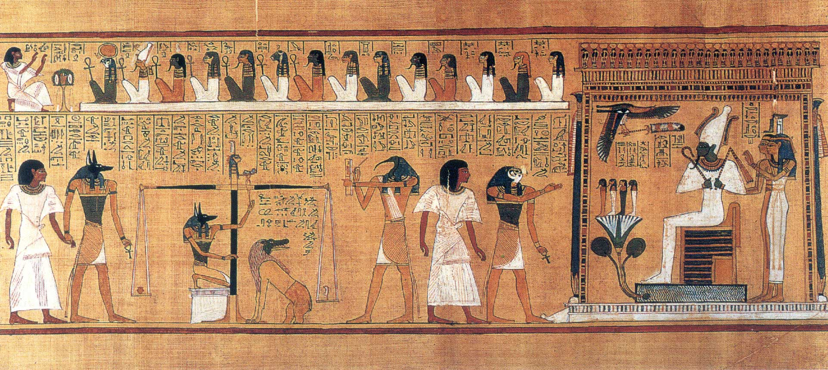
Ultimately, our goal was to create an effective and efficient sampling method to target specific individual members of covert groups hidden within a social network.

Slide 47
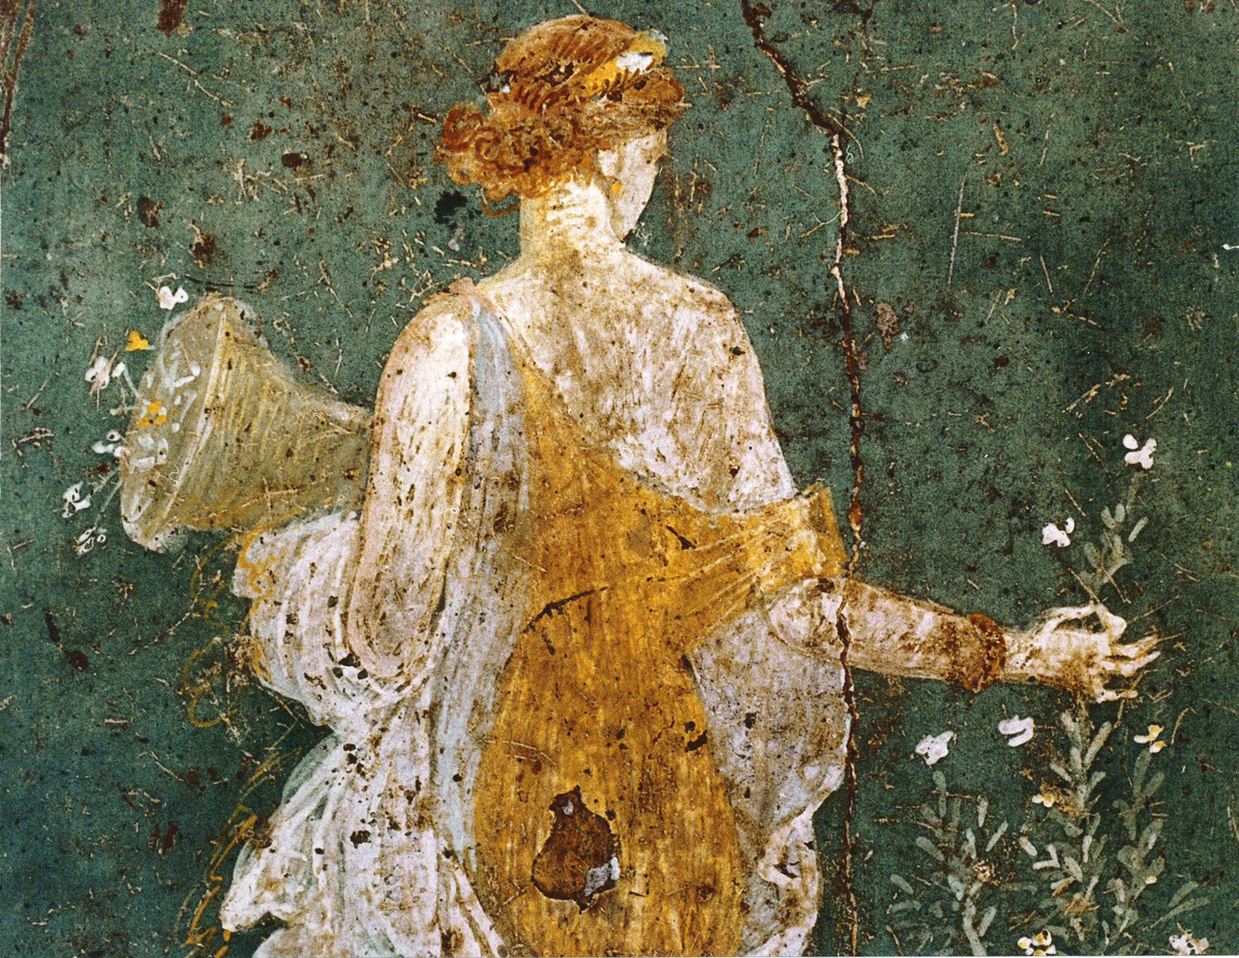
The opportunities and choices offered to students are not theoretical.
Notes:
We need our students to apply all of the knowledge and experience they have. They need to realize that their unique perspective, and their judgment about what is good and what is acceptable should be brought to bear on all of their work.
Your students will have many opportunities to change the world and to have real impact. The more they master mathematics and its applications, the more opportunities they will be offered, and the larger impact they will have.
I would like to explore just a few areas where there are deep moral implications to the quantitative analyses and judgments being rendered.

Slide 48

Waze Versus Suburbs
Notes:
http://www.slate.com/blogs/moneybox/2017/06/16/suburbs_finally_figured_out_a_way_to_get_rid_of_pesky_drivers_on_waze_short.html

Slide 49
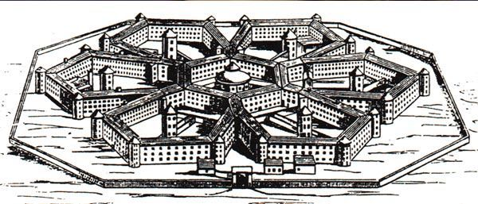
Building the Panopticon
Notes:
http://www.newsweek.com/lets-not-be-too-hasty-shut-down-big-data-security-sweeps-399115
http://www.slate.com/articles/technology/future_tense/2016/02/how_to_bring_better_ethics_to_data_science.html
https://www.citylab.com/life/2017/04/how-to-disappear/524007/?utm_source=nl__link2_042517
http://bdes.datasociety.net/
https://chinacopyrightandmedia.wordpress.com/2014/06/14/planning-outline-for-the-construction-of-a-social-credit-system-2014-2020/

Slide 50

Notes:
http://www.nybooks.com/articles/2017/04/20/kahneman-tversky-invisible-mind-manipulators/?utm_medium=email&utm_campaign=NYR%20Kurds%20Podhoretz%20Chaplin%20Iran&utm_content=NYR%20Kurds%20Podhoretz%20Chaplin%20Iran+CID_5128cc5fcdfd8b56622ec58d0102b5f3&utm_source=Newsletter&utm_term=Invisible%20Manipulators%20of%20Your%20Mind
https://digg.com/2015/myers-briggs-secret-history

Slide 51
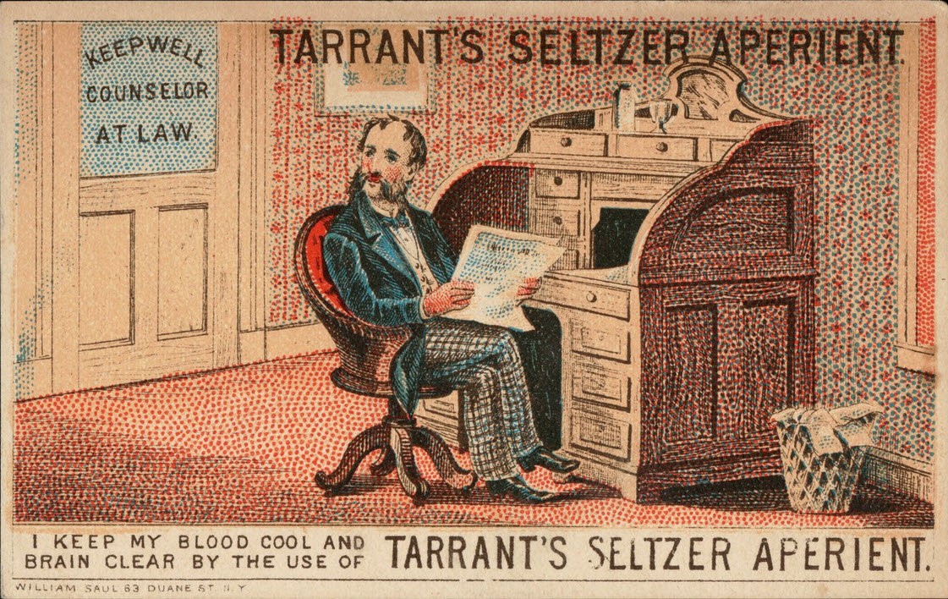
Notes:
https://medium.freecodecamp.org/the-code-im-still-ashamed-of-e4c021dff55e

Slide 52
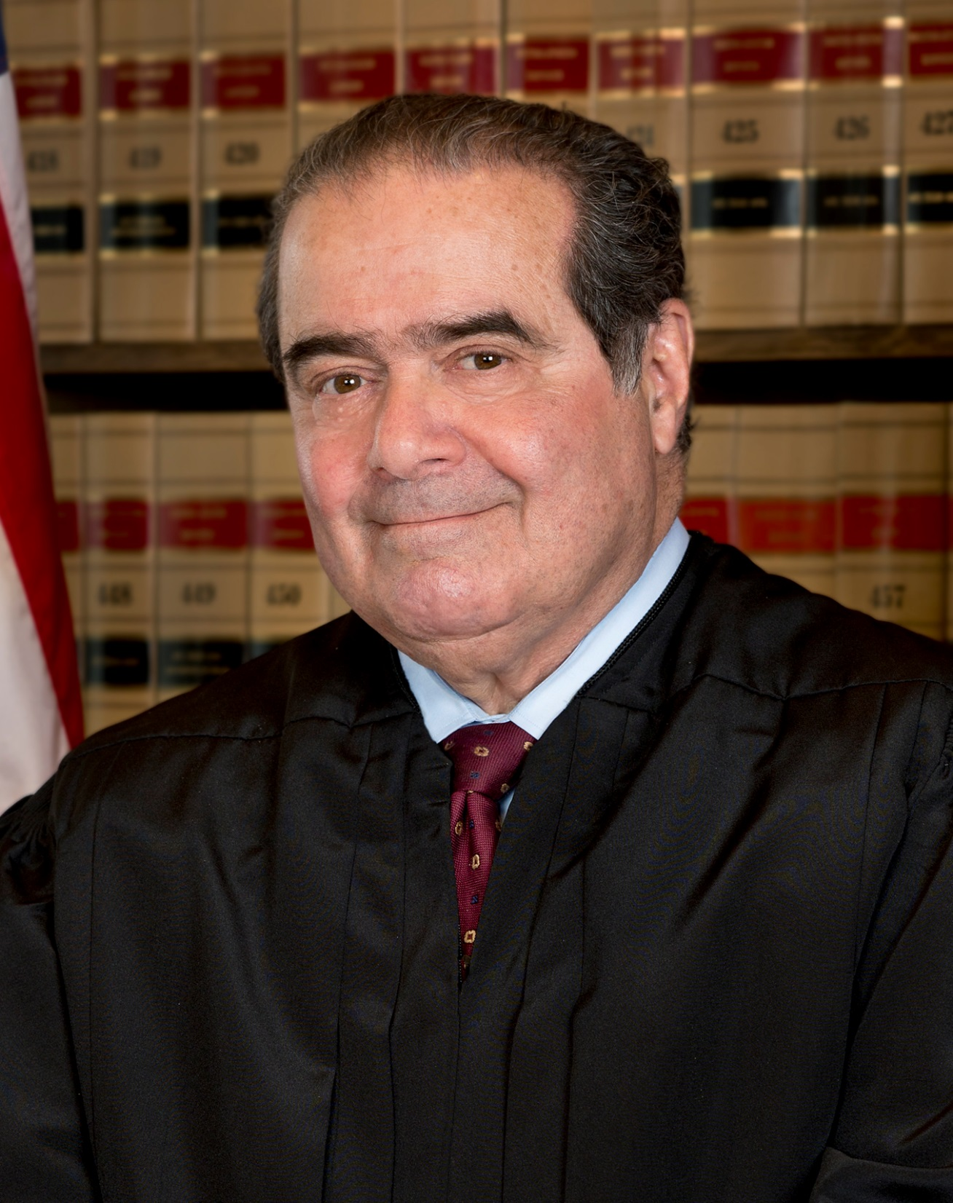
“Originalism is sort of subspecies of textualism. Textualism means you are governed by the text. That's the only thing that is relevant to your decision, not whether the outcome is desirable, not whether legislative history says this or that. But the text of the statute.”
“Words have meaning. And their meaning doesn't change.”
Notes:
https://medium.com/@JSEllenberg/antonin-scalia-thought-jurisprudence-was-more-like-math-than-it-really-is-885cf6eb6bc
Originalism is sort of subspecies of textualism. Textualism means you are governed by the text. That's the only thing that is relevant to your decision, not whether the outcome is desirable, not whether legislative history says this or that. But the text of the statute.
Read more at: https://www.brainyquote.com/quotes/quotes/a/antoninsca740720.html
Words have meaning. And their meaning doesn't change.
Read more at: https://www.brainyquote.com/quotes/quotes/a/antoninsca740723.html

Slide 53
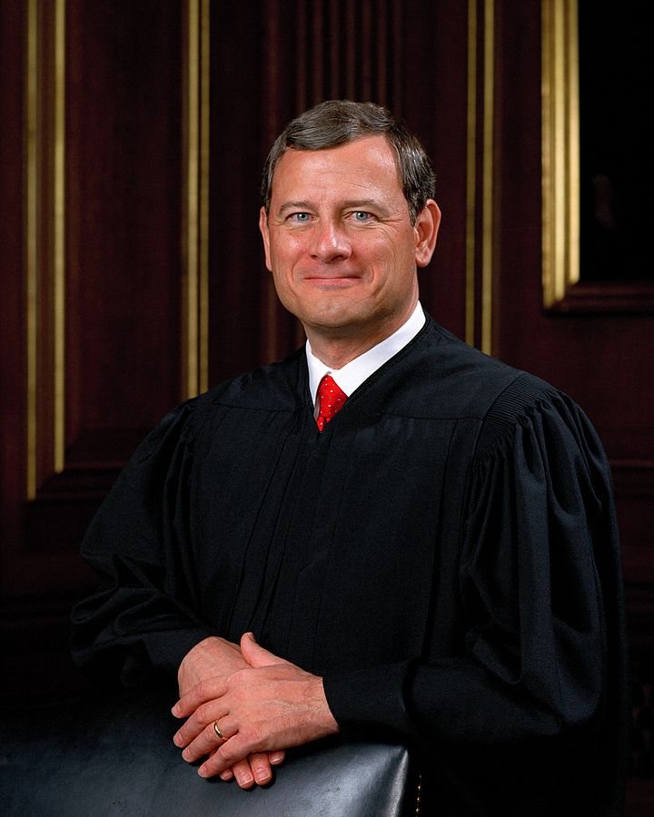
“What unique perspective does a minority student bring to a physics class?”
– Chief Justice John Roberts
Notes:
This particular question by Chief Justice Roberts during Fisher v. University of Texas shows that he does not really understand science, how it is applied or the impact that it can have. The examples so far illustrate the extent to which unrecognized or intentional biases prevent analysis from providing accurate or equitable input to public policy. Just last week the Federal Trade Commission released their own report detailing the responsibility of business to ensure that the use of big data and its associated predictive algorithms don’t unfairly burden or exclude segments of the population. Diversity of opinion is vital to good application of analysis.

